Slide 1
SCM 651: Business Analytics
Week 9

Slide 2
Agenda
Overview of homework #4 (Logit, Probit, Neural networks)
Review of hands-on exercises
Group discussion of articles
What Businesses Can Learn from Sports Analytics?
Team GB: Using Analytics (and Intuition) to Improve Performance

Slide 3
Homework #4
Logit and probit analysis (see week 8)
Moderating effects (week 7)
Final logit & probit models with interaction effects (moderating effects), prediction of outcome, sensitivity analysis
Neural network analysis
Neural network prediction model and sensitivity analysis (new material in handout in week 8)

Slide 4
Week 8 – Regression Assumptions
There are several assumptions of linear regression.
The relationships are linear
The X variables (explanatory variables) are not correlated
Distribution of residuals
The error terms have constant variance.
The errors terms are not correlated.
There are no outliers.

Slide 5
Week 8 – Regression Assumptions
Violations
Nonlinearity
Multicollinearity
Heteroscedasticity
Serial correlation
Outliers
Test
RESET
Variance inflation factor (VIF)
Breusch-Pagan
Durbin-Watson
Bonferroni

Slide 6
Week 8 – Regression Assumptions
Violations
Nonlinearity
Multicollinearity
Heteroscedasticity
Serial correlation
Outliers
Correction
Box-Cox, Box-Tidwell
Factor analysis
Huber regression
Prais-Winsten
Drop outlier

Slide 7
Week 8 – Non-linearity
Problem: data is nonlinear
Test: RESET
Correction: Box-Cox and Box-Tidwell

Slide 8
Week 8 – Multi-collinearity
Problem: X-variables are correlated
Test: variance inflation factor (VIF)
Correction: factor analysis

Slide 9
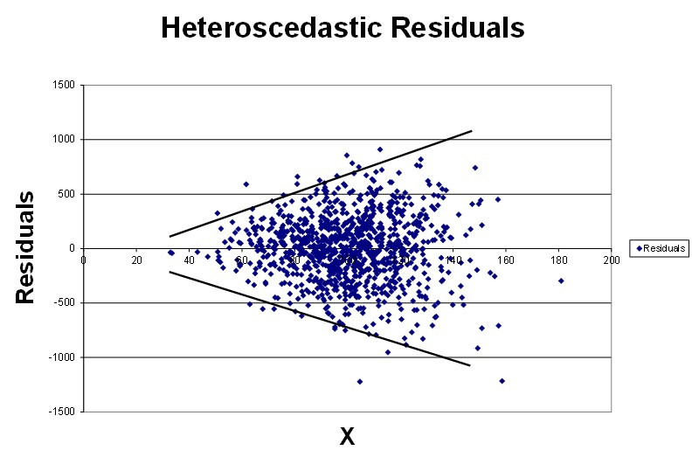
Week 8 – Heteroscedasticity
Problem: magnitude of residuals changes as X changes (nonconstant variance)
Test: Breusch-Pagan
Correction: Huber regression

Slide 10
Week 8 – Serial Correlation
Problem: error terms are correlated
Test: Durbin-Watson
Correction: Prais-Winsten, Cochrane-Orcutt, ARCH, rho-differencing

Slide 11
Week 8 – Outliers
Problem: outliers are data points far from the line, artificially influencing the slope
Test: Bonferroni
Correction: drop outliers

Slide 12
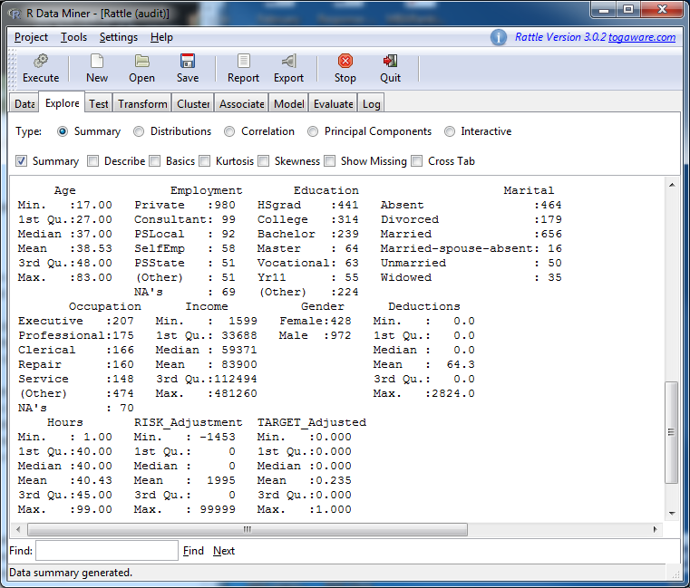
Week 8 – Data Mining
Rattle is a data mining package in R which can create summary statistics including:
Quartiles across multiple variables simultaneously

Slide 13
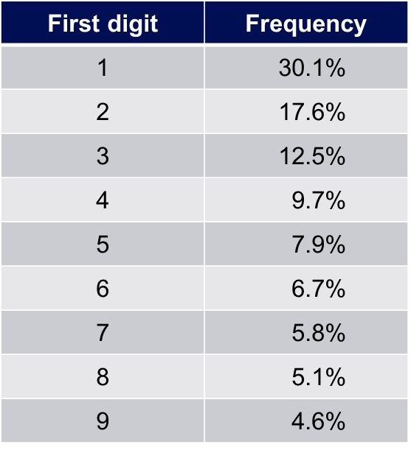
Week 8 – Benford’s Law
Benford’s law states that financial numbers tend to start with smaller digits.
Deviations from this distribution are often a signal of fraud.
Benford’s law can detect fraud in expense reports, accounts receivable, accounts payable, financial statements, and income tax returns.

Slide 14
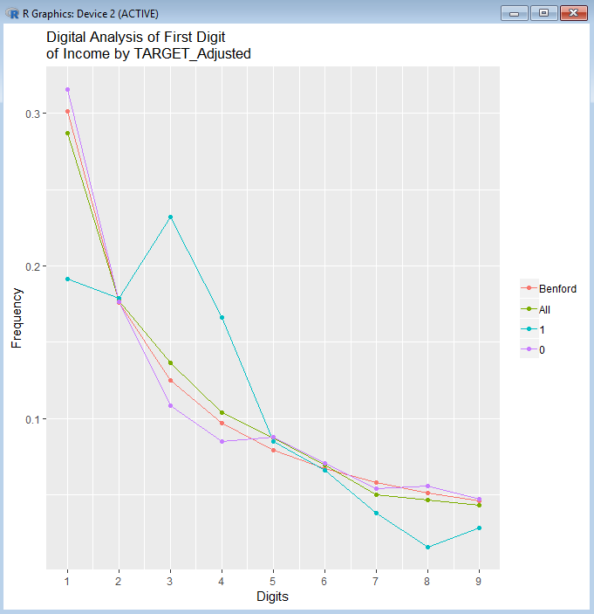
Week 8 – Benford’s Law
Deviations from Benford’s distribution can signal fraud.
The graph on the right shows the first digit of income on tax returns
Group 1 returns were found to be fraudulent; group 0 were not fraudulent

Slide 15
Why are open-source statistical programming languages the best?
Because they R.

Slide 16
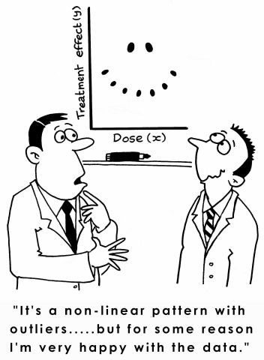
Outliers

Slide 17
Article #1: What Businesses Can Learn from Sports Analytics
What Businesses Can Learn from Sports Analytics
Describe the five key lessons of analytics in sports (give an example of each)

Slide 18
Article #1: What Businesses Can Learn from Sports Analytics
What Businesses Can Learn from Sports Analytics
Describe the five key lessons of analytics in sports (give an example of each)
Align leadership at multiple levels
Player acquisition, player payment, strategies for performance
Focus on human dimension
Individual-level game performance
Performance in context (plus/minus analysis)
Exploit locational data
NYY player acquisition based on homerun measurement
Broader ecosystem (partnerships)
Business operations, dynamic ticket pricing, digital strategy
Support “analytic amateurs”
Players becoming analytics specialists

Slide 19
Article #2: Team GB: Using Analytics (and Intuition) to Improve Performance
Team GB: Using Analytics (and Intuition) to Improve Performance
What is the value of predicting team performance? (page 2)
What is the biggest challenge? (page 2)
What are some of the barriers? (page 3)
Where is the power of the data? (page 5)

Slide 20
Article #2: Team GB: Using Analytics (and Intuition) to Improve Performance
Team GB: Using Analytics (and Intuition) to Improve Performance
What is the value of predicting team performance? (page 2)
Priorities: GB only funds sports which are likely to produce medals
What is the biggest challenge? (page 2)
Difficulty in collecting data – some sports are hard to collect
What are some of the barriers? (page 3)
Elite coaches rely on experience, rather than data
Where is the power of the data? (page 5)
Longitudinal data rather than snapshots

